Slide 1



Dynamics 365 FastTrack Architecture Insights
Create real-time and contextualized Power BI reports in your apps
Henry Jammes
Principal FastTrack Solution Architect
/in/henryjammes
@HenryJammes

Slide 2






Agenda
Power BI in Power Apps & Dynamics 365
Reporting options on Dataverse data
Using the Dataverse connector
Resources

Slide 3
Power BI integration in Power Apps & Dynamics 365

Slide 4


Road to Power BI success in your apps
✅ | Define what the report should help solve or analyze and the intended audience. This will determine the report type (Dashboard, Analytical, Operational…)
✅ | Define the underlying data model that will support the report.
✅ | Assess how the data should be accessed (directly through Dataverse or through Azure Synapse, etc.)
✅ | Build the report and choose visuals that will highlight key information surfaced in the report.
✅ | Publish the report to the Power BI service and configure the connections (refresh, DirectQuery settings…)
✅ | Share the report so that it’s accessible by the target users.
✅ | Embed the report into your apps in the relevant places (dashboard, form…)
✅ | Deploy your apps and reports (Application Lifecycle Management)
✅ | Iterate: either evolve the original dataset or create new queries supporting new business insights.
🏁
4

Slide 5
Power BI in Power Apps & Dynamics 365
Platform | Component | Power BI Report | Power BI Dashboard | Power BI Tile | Power BI Quick Create
Power Apps | System dashboard | ✓ | ✓ | ✕ | ✕
 | Personal dashboard | ✕ | ✓ | ✓ | ✕
 | Main form | ✓ | ✕ | ✓ | ✕
 | View | ✕ | ✕ | ✕ | ✓
 | Custom page | ✕ | ✕ | ✕ | ✕
 | Canvas app | ✕ | ✕ | ✓ | ✕
 | Portal | ✓ | ✓ | ✓ | ✕
Dynamics 365 F&O apps | Workspace | ✕ | ✕ | ✕ | ✕
Considerations:
Only system dashboards support environment variables (better ALM)

Slide 6
Power Apps and Power Automate in Power BI
Power BI Component | Power Apps canvas app | Power Automate cloud flow
Report visual | ✓ | ✓
Considerations:
Power Automate cloud flows need to be deployed in the default environment.
The maximum number of records that can be passed from Power BI to Power Apps visual is limited to 1000.

Slide 7


Power BI access & licensing
In most cases (for example for reports embedded in system dashboards or in forms), the Power BI reports are published to a Power BI workspace.
Managing user access to Power BI reports and dashboards
Power BI reports and dashboards need to be shared with the users or Azure Active Directory (AAD) groups who need to access them.
This must be done independently from the Power Apps or Dynamics 365 configuration.
Power BI licensing requirements
A Power BI report or dashboard stored in a workspace can be accessed either by:
An authenticated AAD user with either a Power BI Pro or Premium per user license
Any authenticated AAD users, if the report is stored in a Power BI workspace associated with a Premium capacity.

Slide 8
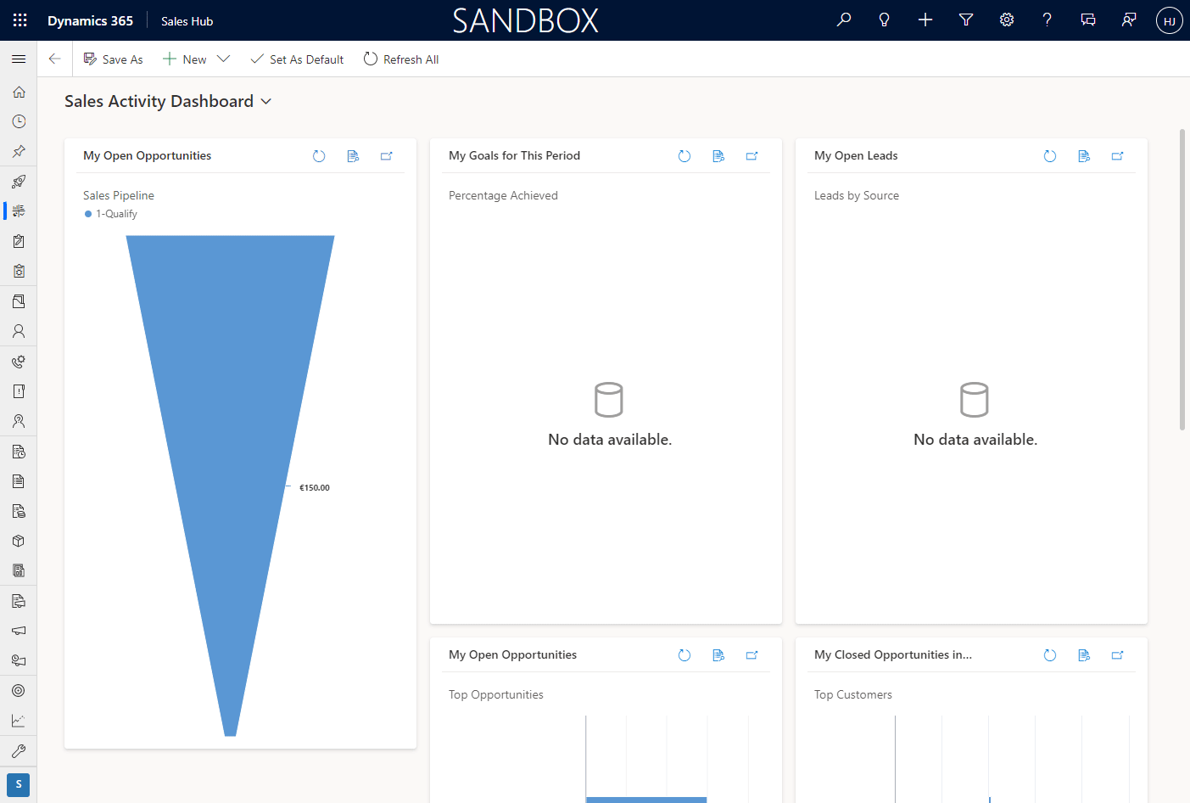
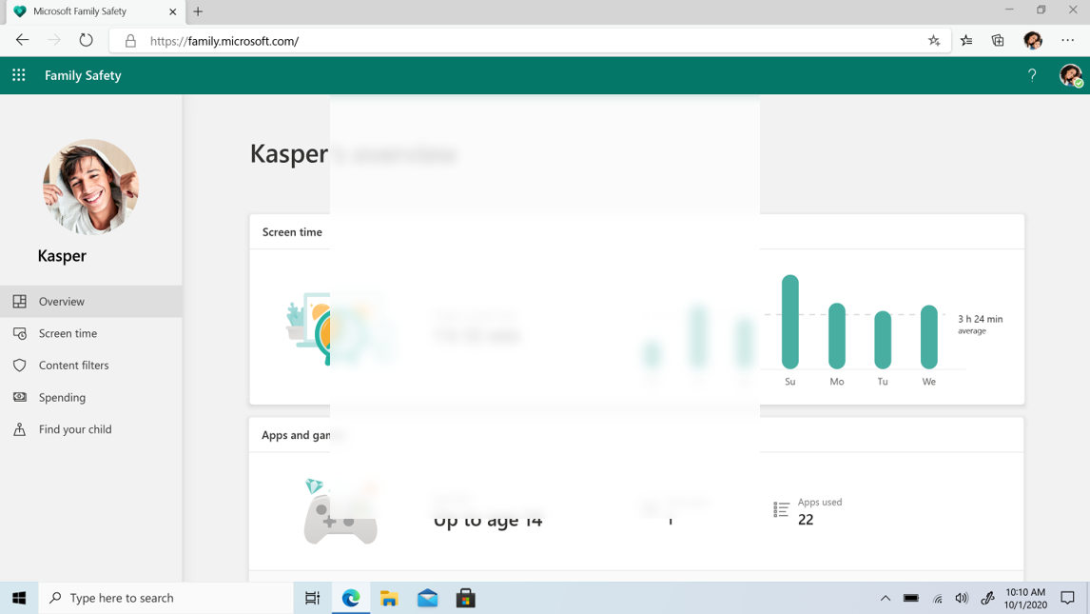
🤩 Displaying a Power BI report in a dashboard
Welcome your app users with user-contextualized insights.
💡 Let users act on the presented data by integrating cloud flows and canvas app visuals.

Slide 9
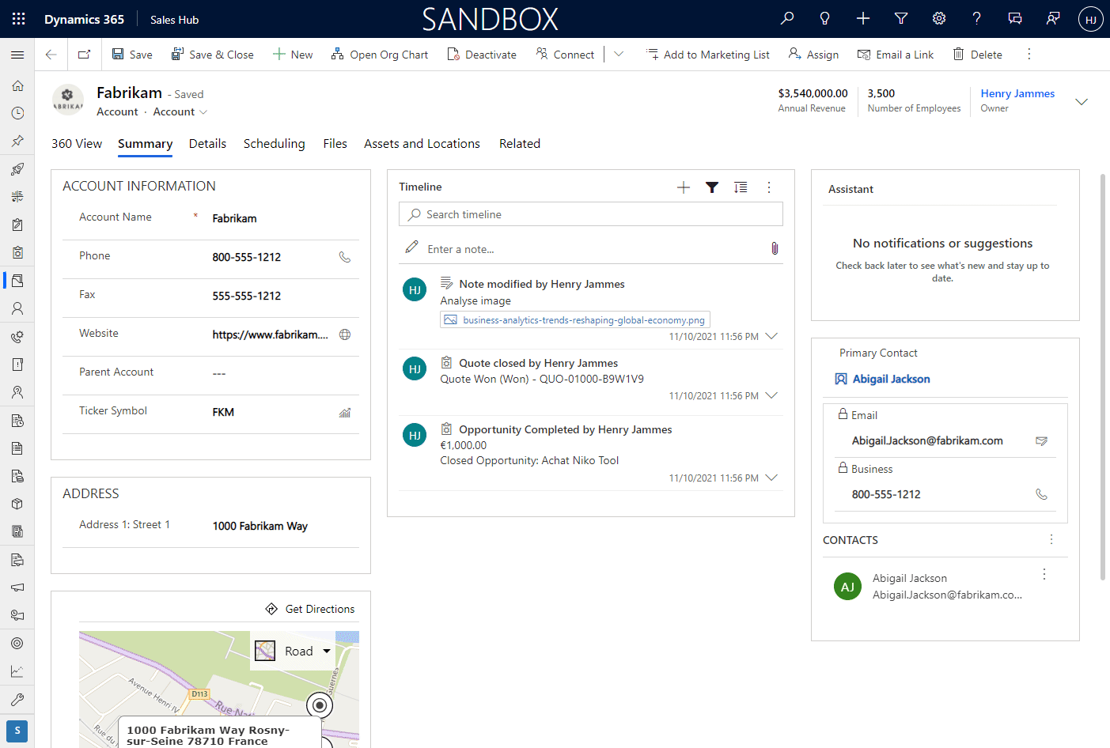
🤩 Displaying a Power BI report in a main form
Reports in forms can be contextualized to the record, offering a 360 view.
💡 Multiple data sources can be used to visualize data beyond what is stored in Dataverse.

Slide 10
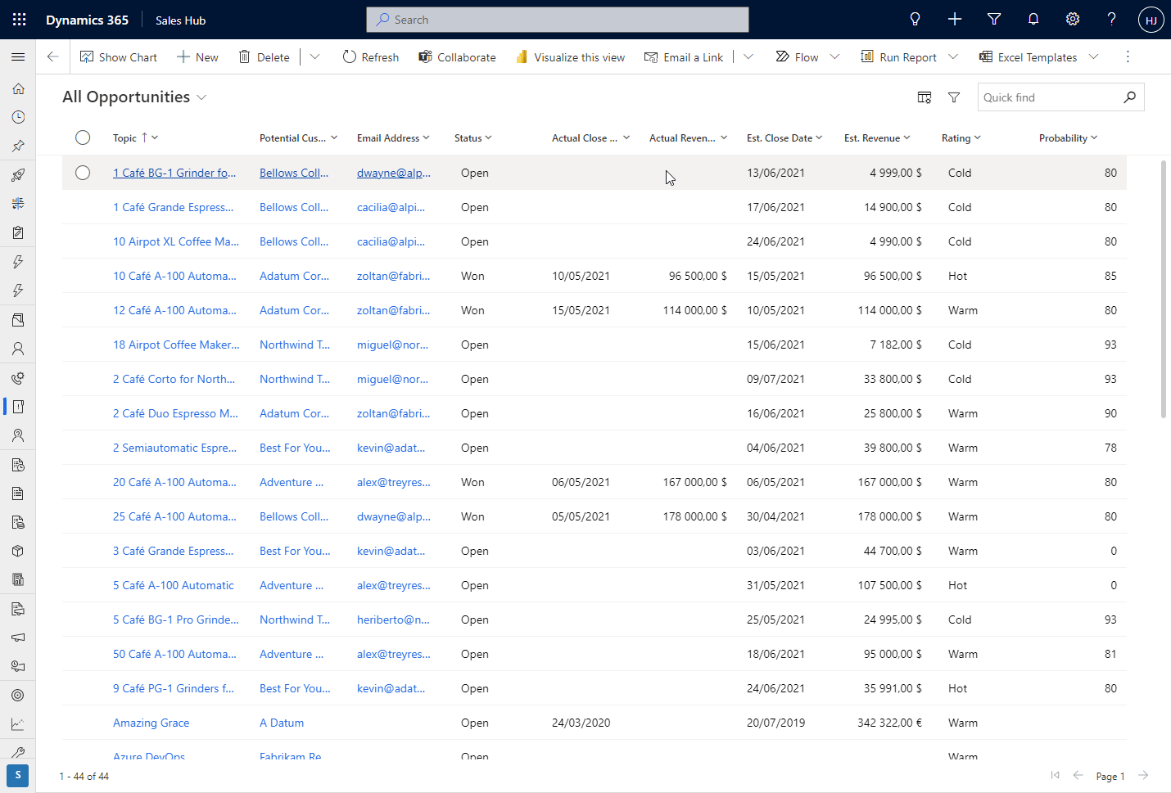
🤩 Explore data with Power BI Quick Create
Quickly explore data with Power BI right from model-driven app views
💡 View definitions & filters are retained by Power BI.

Slide 11
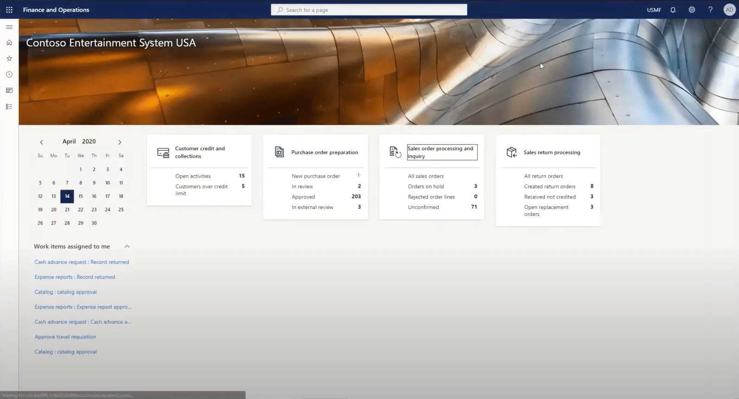
🤩 Displaying a Power BI report in a workspace
Embed reports into a workspace from either:
Reporting services (limited to entity store data)
Power BI service (more data sources and capabilities).

Slide 12
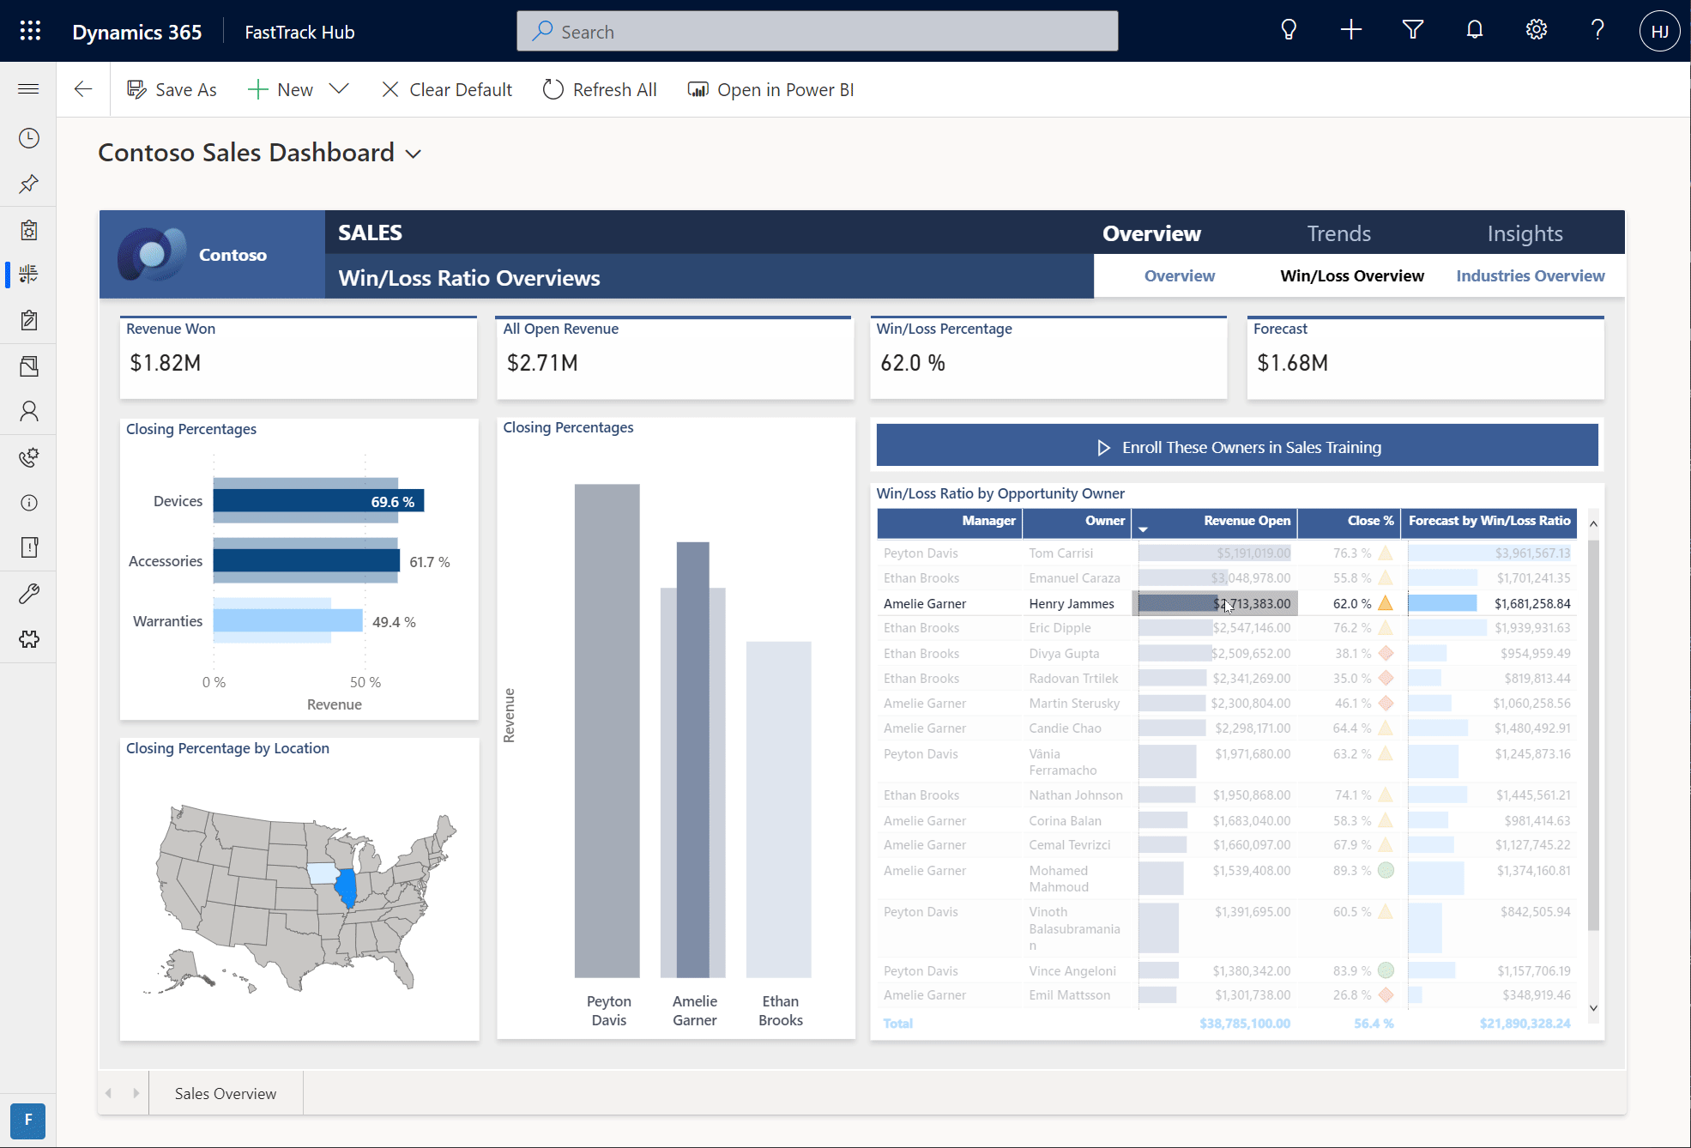
🤯 Make reports interactive with Power Automate
Act on data & insights:
Trigger cloud flows on your Power BI dataset records with the Power Automate visual.

Slide 13
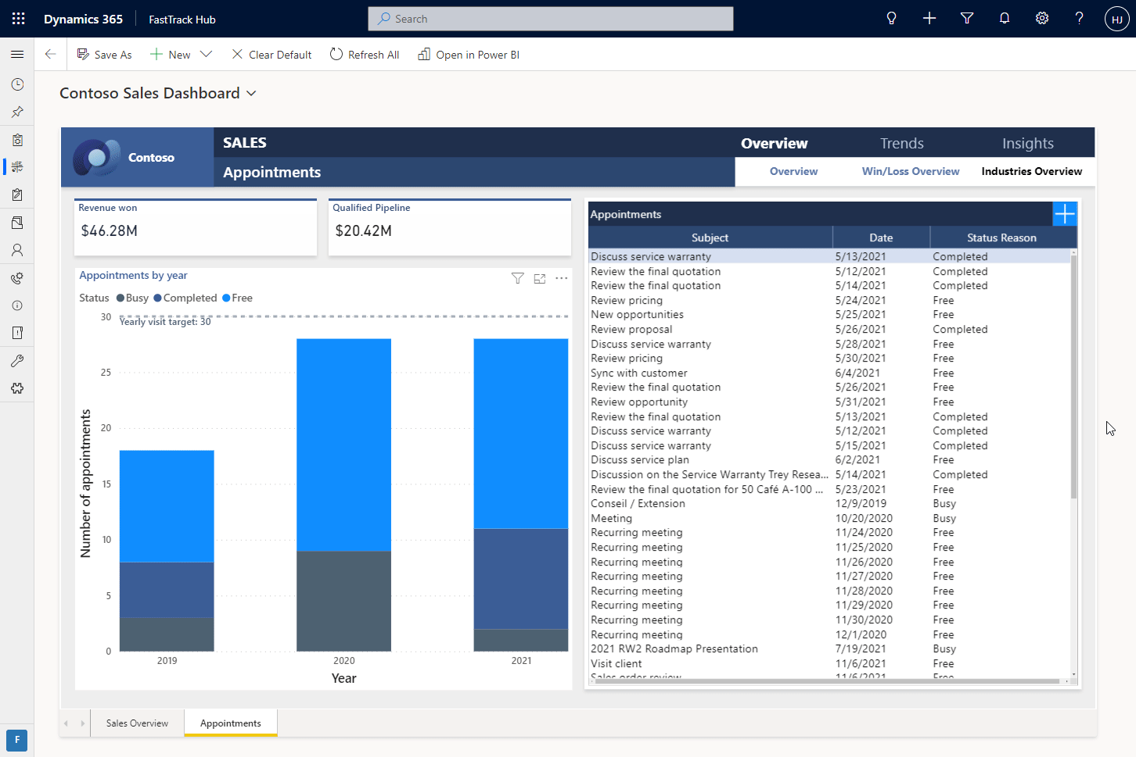
🤯 Make reports interactive with Power Apps
Act on data & insights:
💡 Records in the Power Apps can reflect the applied Power BI filters.
⚡ With DirectQuery, creations or updates done in the Power Apps can be reflected real-time in the report.

Slide 14
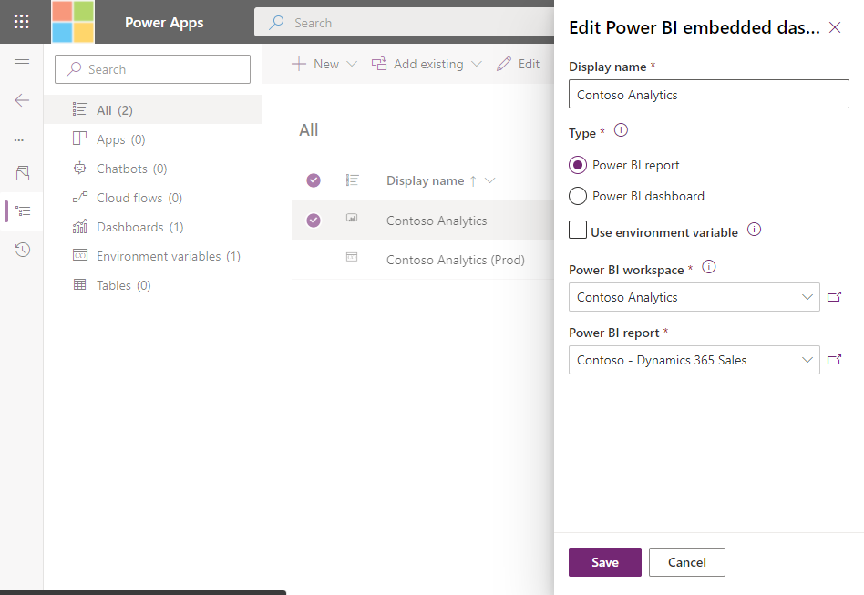
🛠 Embedding a Power BI report into a dashboard
Official documentation:
Create or edit a Power BI embedded system dashboard
💡 Use environment variables to point to different Power BI workspaces and reports in dev/test/prod etc.

Slide 15
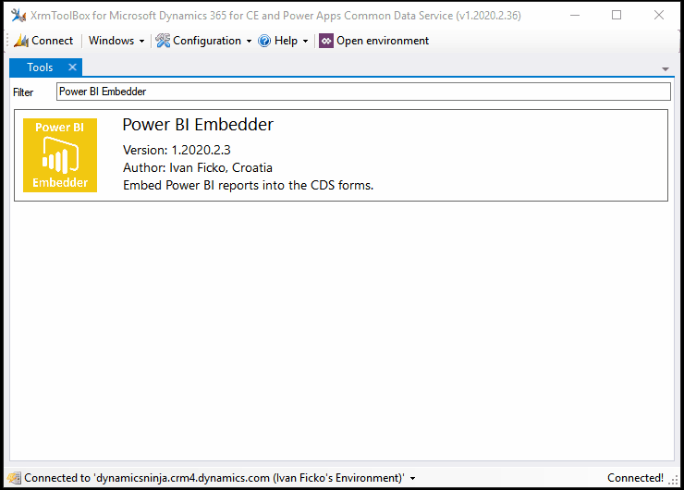


🛠 Embedding a Power BI report into a main form
Official documentation:
Embed a Power BI report in a model-driven app main form
💡 Easiest way: XrmToolBox and the Power BI Embedder tool
Power BI Embedder for XrmToolBox - Dynamics Ninja
Ivan Ficko

Slide 16
Reporting options on Dataverse data

Slide 17


Reporting options on Dataverse data
Dataverse connector
Supports both Import Mode and DirectQuery
Based on the TDS endpoint (80-MB limit on query result, no paging)
Common Data Service (legacy) connector
Only supports Import Mode
Based on the Web API: supports more data types and paging
Azure Synapse Analytics SQL connector
Supports both Import Mode and DirectQuery
Requires Azure Synapse Link for Dataverse to be setup
Enterprise-Scale data source for reporting

Slide 18


Import Mode VS DirectQuery
Import Mode
Scheduled refreshes of medium-sized datasets.
As data gets cached in the Power BI Service, Dataverse security model no longer applies, unless row-level security (RLS) is implemented on the Power BI side.
Highly responsive user interactions.
Lowered complexity of query.
As data is cached in Power BI, less impact on Power Platform Requests.
DirectQuery
Real-time.
Dataverse security model applies (the connected user security context is applied).
Best for targeted datasets.
Additional limitations in Power BI (DirectQuery considerations and limitations).

Slide 19
Dataverse connector in Power Query
Benefits:
Available in
Power BI
Excel (future release).
Power Platform Dataflows
DirectQuery support
Native Dataverse SQL statements can be used
Considerations:
TDS endpoint limits apply:
80-MB maximum size limit for query results.
Unsupported datatypes and tables (image, file, audit, etc.)
Dates are formatted as UTC.
Plug-ins registered on the RetrieveMultiple or Retrieve messages are not triggered.
No paging support.

Slide 20
Azure Synapse Link for Dataverse
Benefits:
Getting the Dataverse data to start flowing to the Azure Data Lake is a matter of clicks.
Comes with a serverless SQL pool endpoint you can query with T-SQL.
Works as a data warehouse.
Supports in-place and append modes.
Large volumes and complex queries support.
Also supports Spark and SQL Pools.
Considerations:
Azure Data Lake and Azure Synapse Analytics are billed on an Azure subscription.
Once the data is out of Dataverse, the configured security model is lost (need to add row-level security).
Data flows from Dataverse to the data lake in near-real time, but there is some lag as compared to the DirectQuery approach.

Slide 21
Which connection is ‘right’ for my use case?
Criteria/Complexity
Dataset query result size | Dataverse 80-MB per query | Common Data Service (legacy) Paging support | Azure Synapse Massive
Query complexity | Dataverse Power Query / SQL |  | Azure Synapse Spark, SQL etc.
Data mash-up flexibility | Dataverse + Power Query |  | Azure Synapse Data Warehouse
Latency / Delay of data availability | Dataverse + DirectQuery Real time results |  | Azure Synapse Can only be near-real time
Effort to implement user context | Dataverse + DirectQuery Inherits Existing Security |  | Azure Synapse Row-level security in Power BI
Lower
Higher

Slide 22
Using the Dataverse connector

Slide 23


Using the Dataverse connector in Power BI
 | Using the “Dataverse” button | Using a blank query
Technically, the same “Dataverse” connector, leveraging the TDS endpoint | ✓ | ✓
Environment picker | ✓ | ✕
Table selector | ✓ | ✕
SQL statement support | ✕ | ✓
DirectQuery support | ✓ | ✓
Import Mode support | ✓ | ✓
💡 Note: you can always start with the “Dataverse” button and “Transform Data” afterwards to edit the M query.

Slide 24
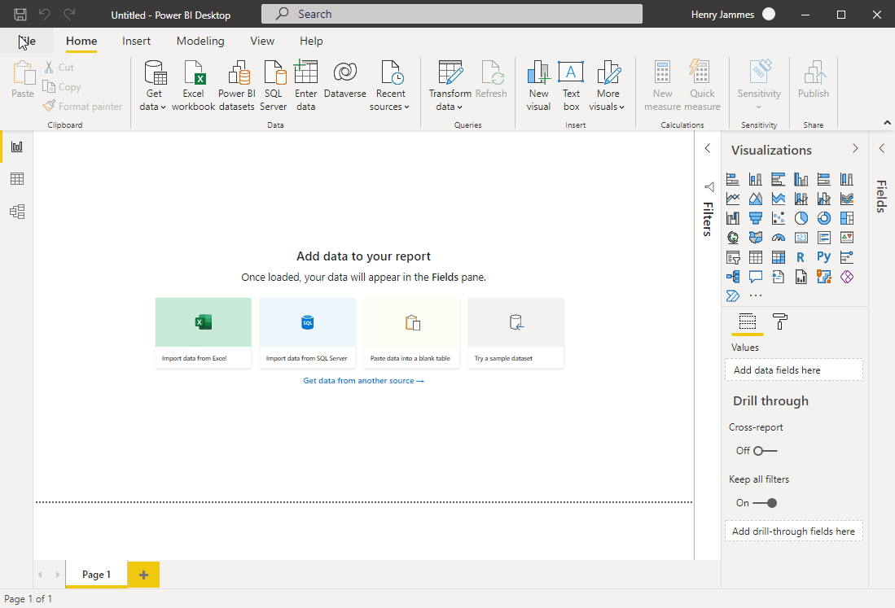
🤩 Dataverse connector in Power BI
Easiest way to get started for citizen report makers, thanks to the environment and table picker.
💡 For best performances, always to transform data in Power Query and remove all unnecessary columns and filter your data.

Slide 25
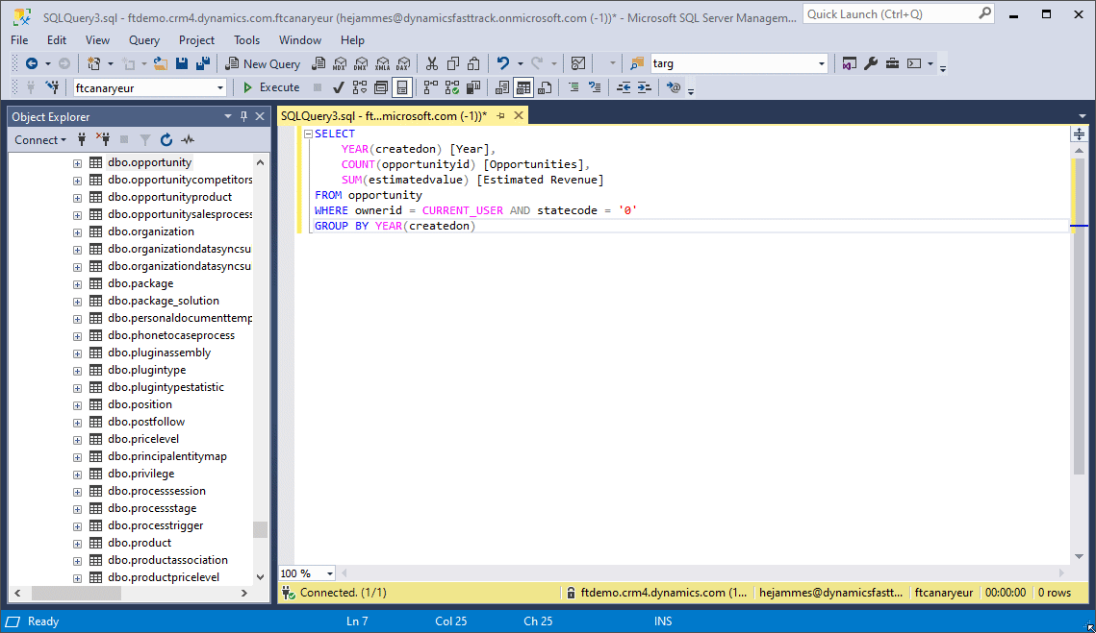
🤩 Using a blank query to use Dataverse SQL
Fast and ideal for report makers who prefer SQL as a query language.
⚡ Datasets can be prepared at the query level with Dataverse SQL aggregates, joins, group by, filters, display names, etc.
💡 With CURRENT_USER and DirectQuery, you can replicate the “My …” (Accounts, etc.) filters.

Slide 26
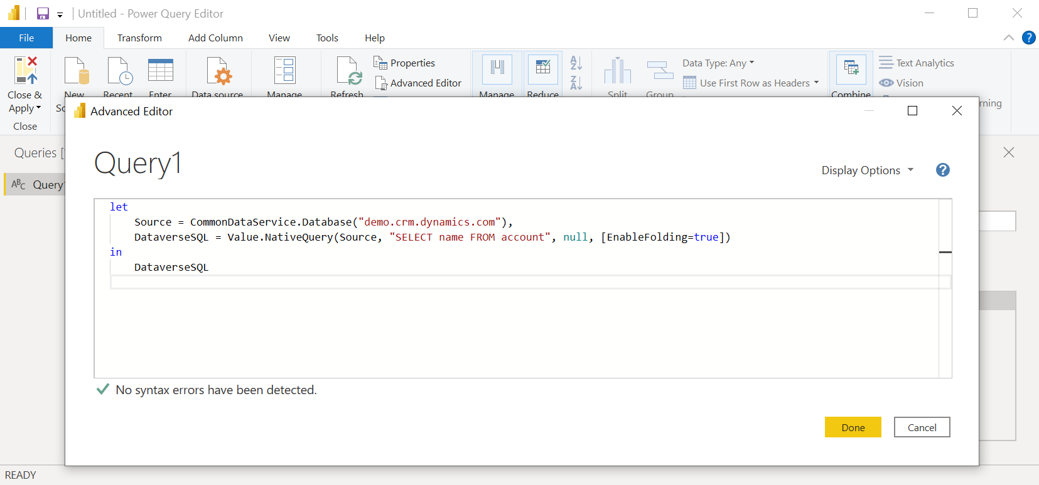
🛠 Using a SQL query with the Dataverse connector
In Power BI, instead of using the Dataverse connector button:
Select “Get Data“, then "Blank Query",
In Power Query, select "Advanced Editor".
Update the M query following this example:
Use the target environment domain
let
Source = CommonDataService.Database("demo.crm.dynamics.com"),
DataverseSQL = Value.NativeQuery(Source, "SELECT name FROM account", null, [EnableFolding=true])
in
DataverseSQL
Use the desired SQL statement

Slide 27
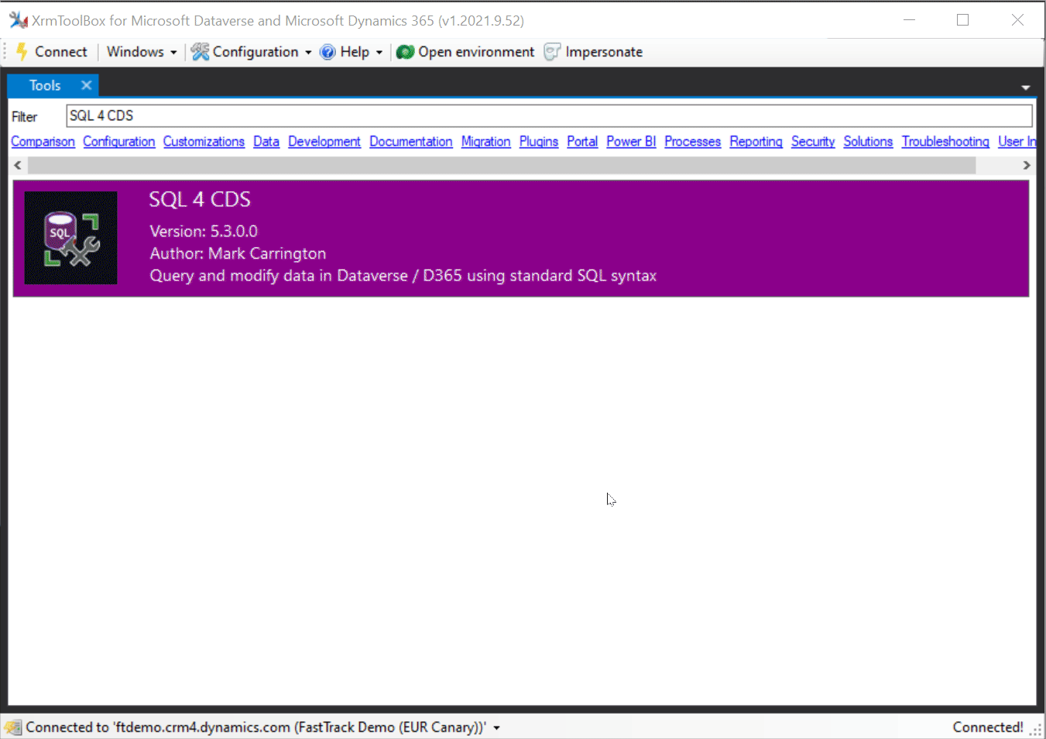

🛠 Preparing your Dataverse SQL statements
SQL Server Management Studio (SSMS)
Use SQL to query data (Microsoft Dataverse)
💡 Or use XrmToolBox and SQL 4 CDS tool for IntelliSense and copy the output M query!
SQL 4 CDS XrmToolBox Tool - Mark Carrington
Mark Carrington

Slide 28
Resources

Slide 29
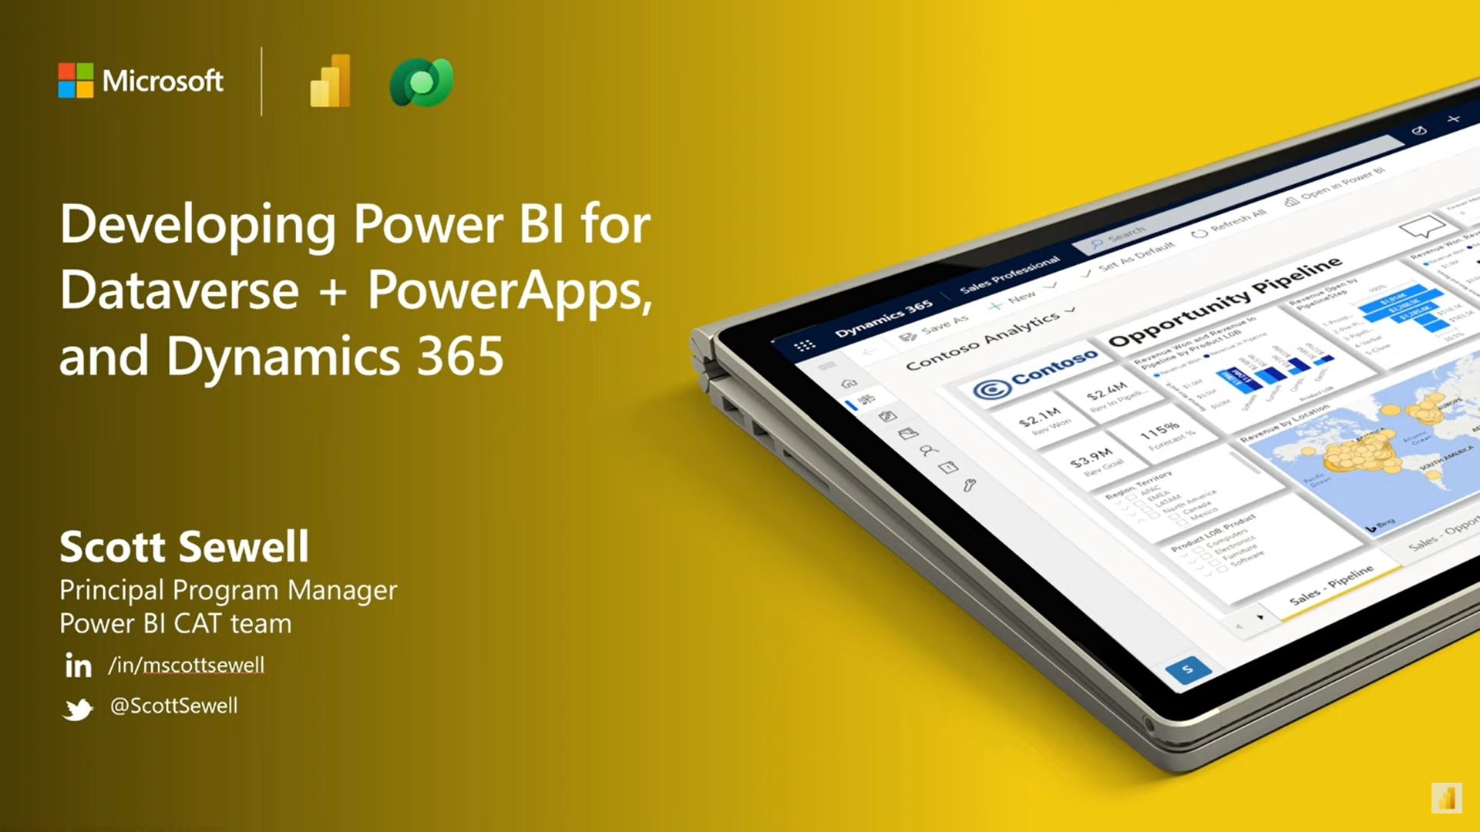
Developing Power BI for Dataverse + Power Apps
YouTube video Hands-on presentation, packed with DirectQuery best practices & tips: https://www.youtube.com/watch?v=9ZGpK2waM5Y
Power BI templates https://github.com/PowerBiDevCamp/Camp-Sessions/tree/master/PBIX
PowerPoint deck: https://github.com/PowerBiDevCamp/Camp-Sessions/raw/master/Session%2014%20-%20Power%20BI%20with%20Dataverse.pptx

Slide 30
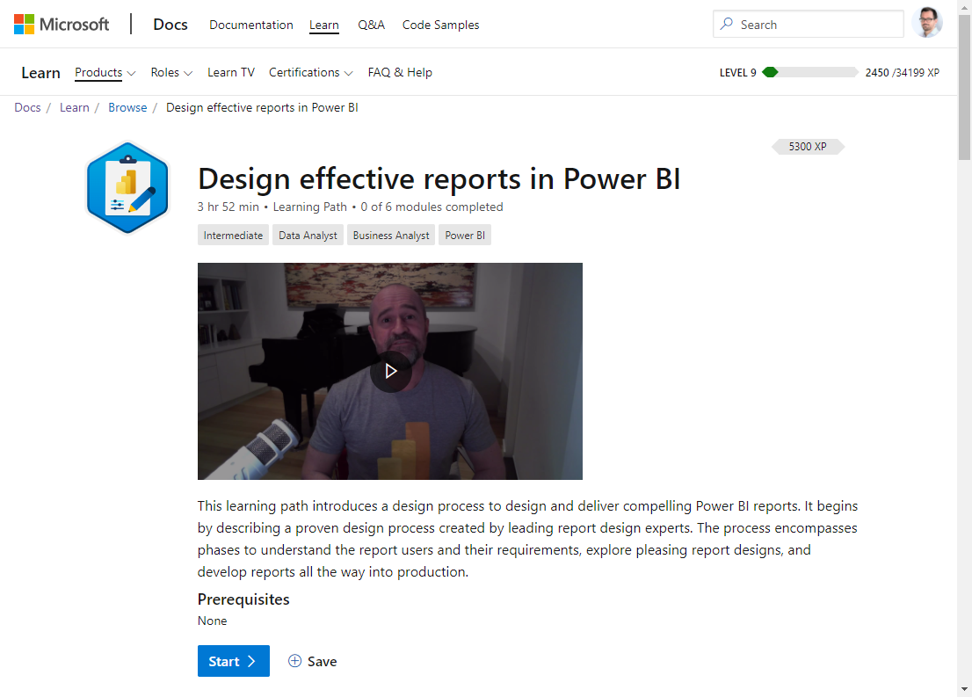
Training: Design effective reports in Power BI
This learning path introduces a design process to design and deliver compelling Power BI reports.
It begins by describing a proven design process created by leading report design experts.
The process encompasses phases to understand the report users and their requirements, explore pleasing report designs, and develop reports all the way into production.
Design effective reports in Power BI - Learn

Slide 31
Microsoft Docs
Use SQL to query data (link)
How Dataverse SQL differs from Transact-SQL (link)
Use Power BI with Dataverse
Overview (link)
View table data in Power BI Desktop (link)
Power Query Dataverse connector (link)
Visualize your data quickly from Power Apps (link)
Embedding Power BI into Power Apps
Create or edit a Power BI embedded system dashboard (link)
Add or edit Power BI visualizations on your dashboard (link)
Embed a Power BI report in a model-driven app main form (link)
Power BI tile control in Power Apps (link)
Embedding Power BI into Dynamics 365 F&O apps
Analytical Workspaces (using Power BI Embedded) (link)
Power BI Embedded integration (link)
Customize embedded reports in analytical workspaces (link)
Power BI DirectQuery
DirectQuery model guidance in Power BI Desktop (link)
DirectQuery model troubleshooting in Power BI Desktop (link)
Use Power Automate in Power BI
Create a Power Automate visual for Power BI (link)
Use Power Apps in Power BI
Power Apps visual for Power BI (link)

Slide 32
Thank you

